Slide 1


Deep Learning for Image Compression
01/31/2018 Final presentation
Jules Abdo, Romain Boisseau, Samuel Cattez, Stéphane Kombo
Notes:
Intro Contexte: canaux mobiles….

Slide 2
Contents
Our work
SRGAN
Prediction
Colorization
The final pipeline
Now what?

Slide 3
Introduction to the project and its tasks
Our Goal : Provide information through slow networks
(ie. mobile networks in developing countries)
Find a way to have a better image compression
Using Prediction, Colorization and Super Resolution to achieve it.
Notes:
Investigate way of pre and post-treating

Slide 4
SRGAN
Generative Adversarial Networks (GANs): Engine and Applications (2017)
Anton Karazeev on https://blog.statsbot.co/generative-adversarial-networks-gans-engine-and-applications-f96291965b47
Photo-Realistic Single Image Super-Resolution Using a Generative Adversarial Network (2017)
Christian Ledig, Lucas Theis, Ferenc Huszar, Jose Caballero, Andrew Cunningham, Alejandro Acosta, Andrew Aitken, Alykhan Tejani,
Johannes Totz, Zehan Wang, Wenzhe Shi Twitter
Notes:
z

Slide 5
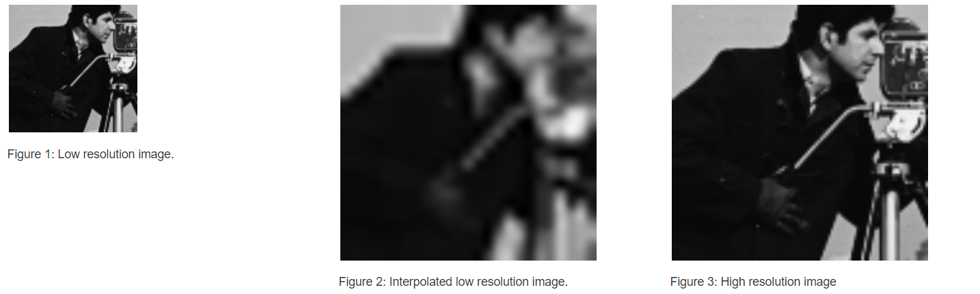
What is a Super Resolution?
Notes:
Super-Resolution in image processing means upsampling and therefore interpolation between pixels of an image.
To make images larger it is necessary to predict the values of the additional pixels between the original pixels. One of the easiest ways and also a traditional method to do this is applying a bicubic interpolation (bilinear, HEVC) . New methods have emerged in the recent years and the use of neural networks is outperforming all other methods developed so far.
# VDSR : 20 convolutional layers.

Slide 6
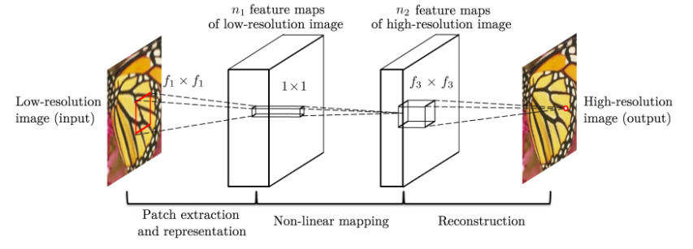
SRCNN?
Notes:
3 layers : 9*9, 1*1, 3*3
The first layer generates 64 feature maps, the second 32 and the last one generates the output.
Only manipulate grayscale images
The first layer filters can be interpreted as feature detectors, such as corners, lines, etc.

Slide 7
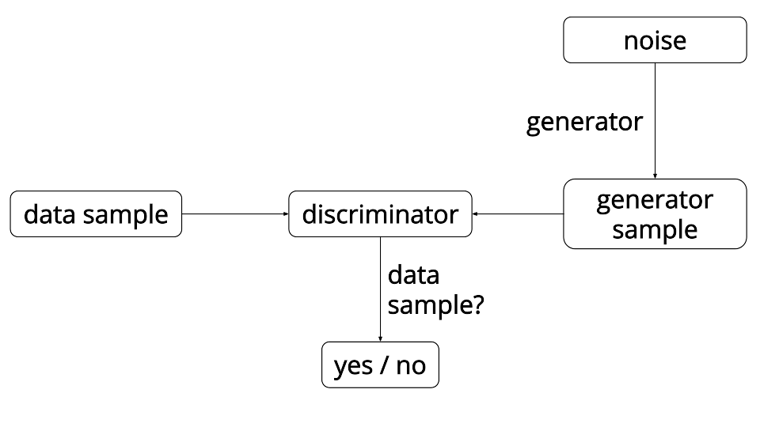
What is a GAN?
Notes:
System of two neural networks contesting with each other.
They were introduced by Ian Goodfellow in 2014
One network generates candidates and the other evaluates them.
Let’s take for example a network that translate text into image. We want the generator to be able to generate image from several categories like “blue bird with brown wings” “This flower has small round violet petals with a dark purple center”.
First we train the discriminator with data sample: we give him a description and an image and it must say if it correspond or not. Once it is trained, we train the generator.

Slide 8
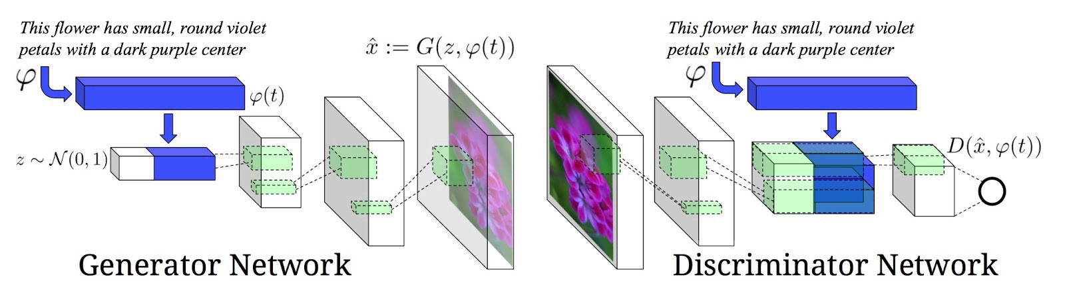
What is a GAN?
Notes:
We enter the description in the generator, which will create an image that must correspond to the sentence.
This image is sent to the discriminator and it will say if it corresponds or not.
In the end you have two trained networks: a Generator and a Discriminator. Now applied to super resolution...

Slide 9
SRGAN
Implementation of "Photo-Realistic Single Image Super-Resolution Using a Generative Adversarial Network"
https://arxiv.org/abs/1609.04802
Zsdonghao
Generator 36 Layers
Discriminator 7 Layers
Training on Div2k (800 professional pictures)
Brade
Pre-trained: RAISE Dataset (8156 high quality pictures)
Our: Training only on B&W faces (1520 small amateur pictures)
Notes:
We found two interesting implementation of the same SRGAN model from this article : …
Both are composed by a 36 layers generator and a 7 layers discriminator.
The differences between those were essentially in the way of using them (how to configure them etc…)
The interest of this article is that the metric the SRGAN uses, is based on human perception, not on PSNR or SSIM.
We found the first one in a github of a certain Zsdonghao, and we trained it with 800 high-quality professional pictures.
The second one (Brade’s) had a pretrained model (trained with a dataset of 8000 pictures) and we also made a new model that we trained only with black and white low-quality pictures of faces (1500).

Slide 10
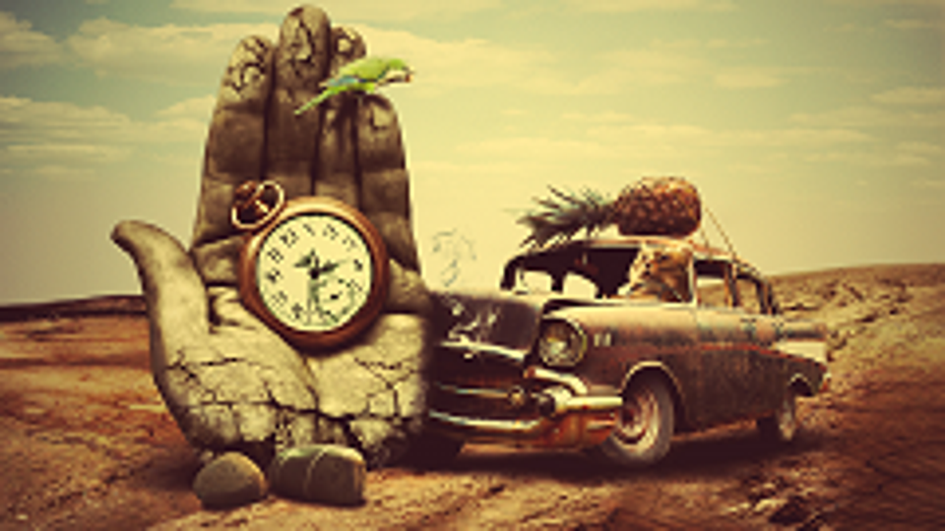
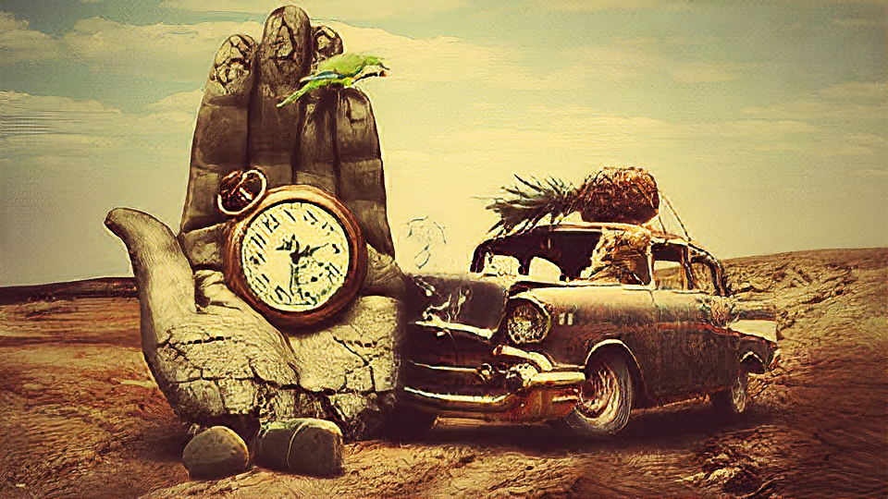
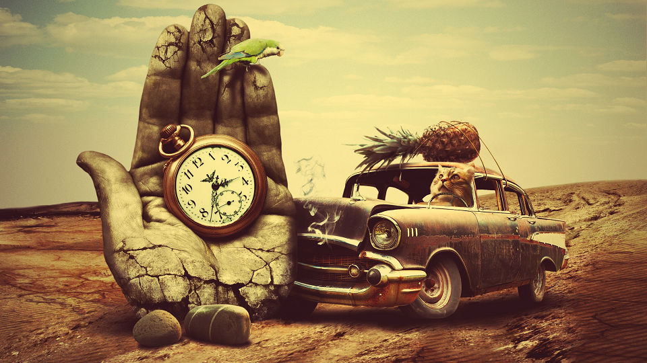
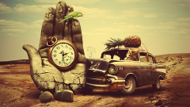
Zsdonghao

Slide 11
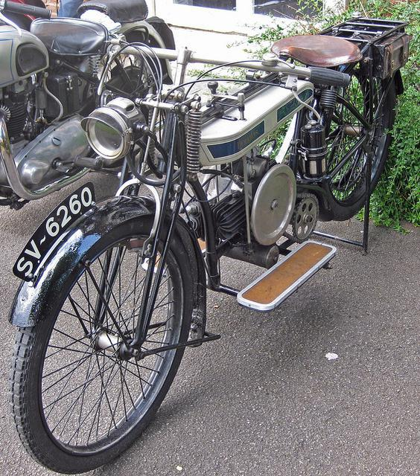
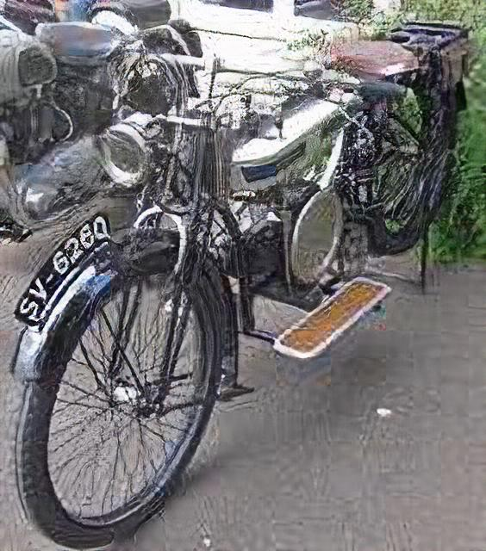
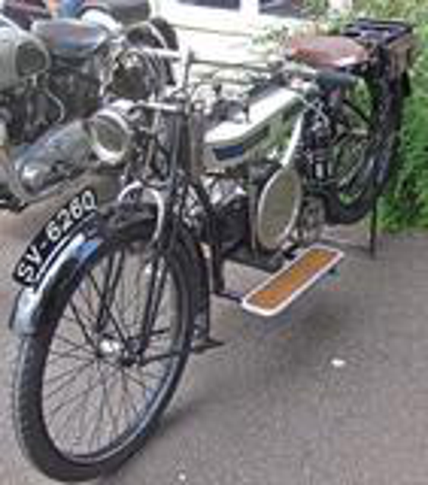


Slide 12
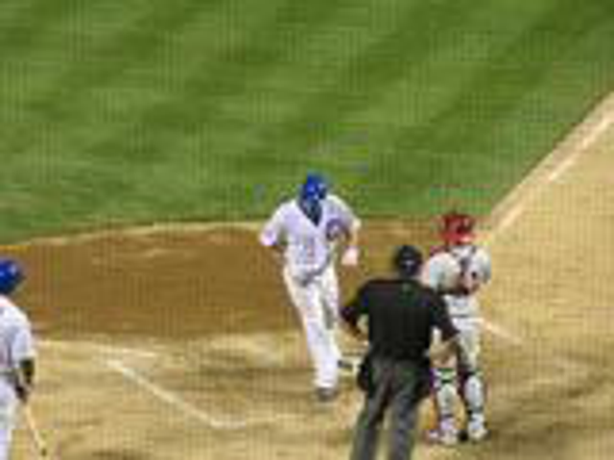

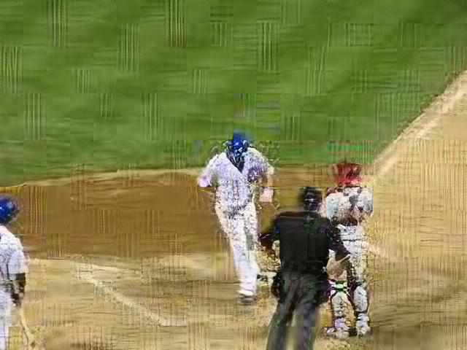


Slide 13
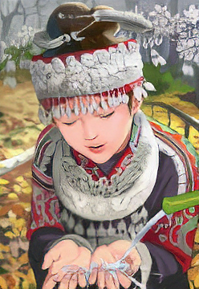
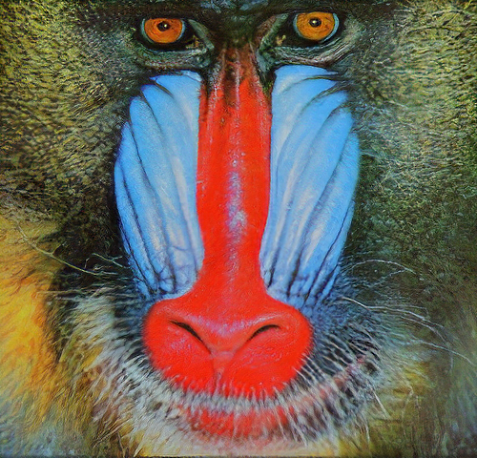


Brade’s pre-trained model

Slide 14
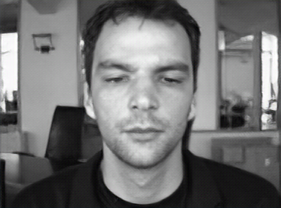
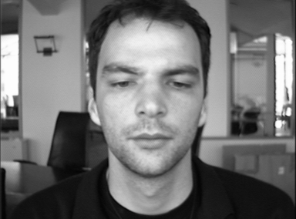

Our training (B&W faces)
Notes:
Qui pense que c’est celle de droite la bonne ?

Slide 15
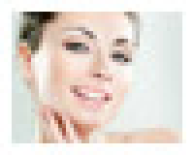
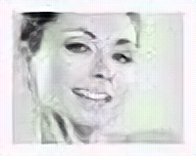

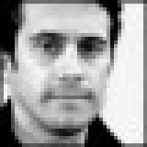
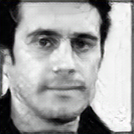

2KB
50x40 px
60KB
200x160 px
Notes:
2.11KB, 50x40 px
=> Get to the limits of the algorithm

Slide 16
Prediction
Generative Adversarial Networks (GANs): Engine and Applications (2017)
Anton Karazeev on https://blog.statsbot.co/generative-adversarial-networks-gans-engine-and-applications-f96291965b47
BPG Image format (2014)
Fabrice Bellard on https://bellard.org/bpg/
Notes:
One of the main part of the compression scheme, managed here by the BPG image format
### DON’T talk about decorrelation

Slide 17
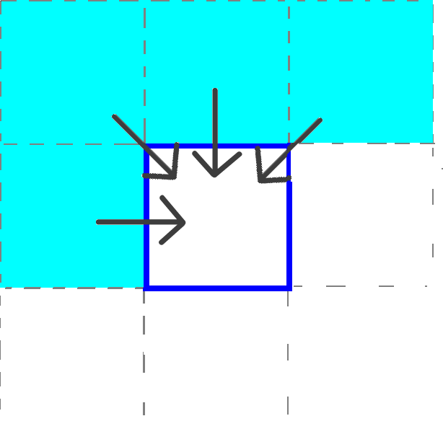
Block per block prediction
Network structure:
Inputs: the previous blocks (in blue)
Labels: block we want to predict
Output: predicted block
We wrote: a script which divide images in blocks for the network’s input
Now: we just have to configure the SRGAN to include the prediction feature
8 x 8
8 x 8
Notes:
Purpose: As in all parts of the project, we wanted au NN to do it.
### But when SR reconstructs a whole image, prediction predicts a part of it without knowing it early.
In class, we learnt how it is possible to do this pixel by pixel => we want our network to do it block per block.
By now, the prediction feature is handled by BPG, a complexe Image format

Slide 18
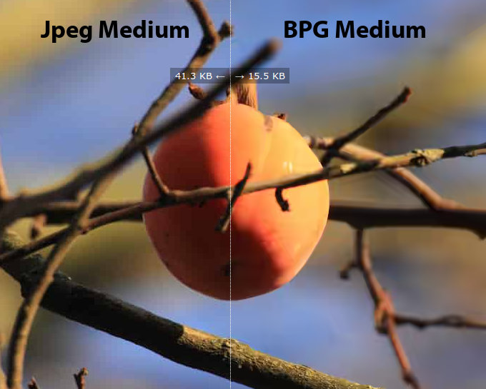
BPG - (Better Portable Graphics)
Invented by Fabrice Bellard in 2014
The best current image compression standard
High compression ratio and flow distortion.
Files are much smaller than JPEG for similar quality.
A subset of the HEVC video compression standard
Prediction for encode the downsized image
Notes:
A new image format : the core of our compression scheme.
#### Prédiction utilisée lors de l’encodage (calcul erreur, mise en mémoire) en BPG et du décodage (somme de l’erreur)
#### on va encoder et décoder avec le même réseau
Forward, we want to give up this complex way of prediction (number of predefined modesas in HEVC) but entirely replace it by deep learning.

Slide 19
Colorization
Multiple hypothesis colorization and its application to image compression
Mohammad Haris Baig, Lorenzo Torresani
Colorful Image Colorization Richard Zhang, Phillip Isola, Alexei A. Efros

Slide 20
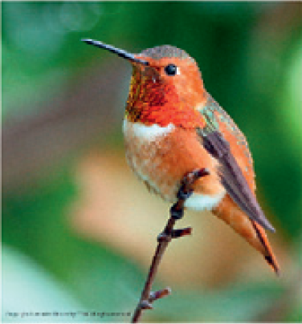
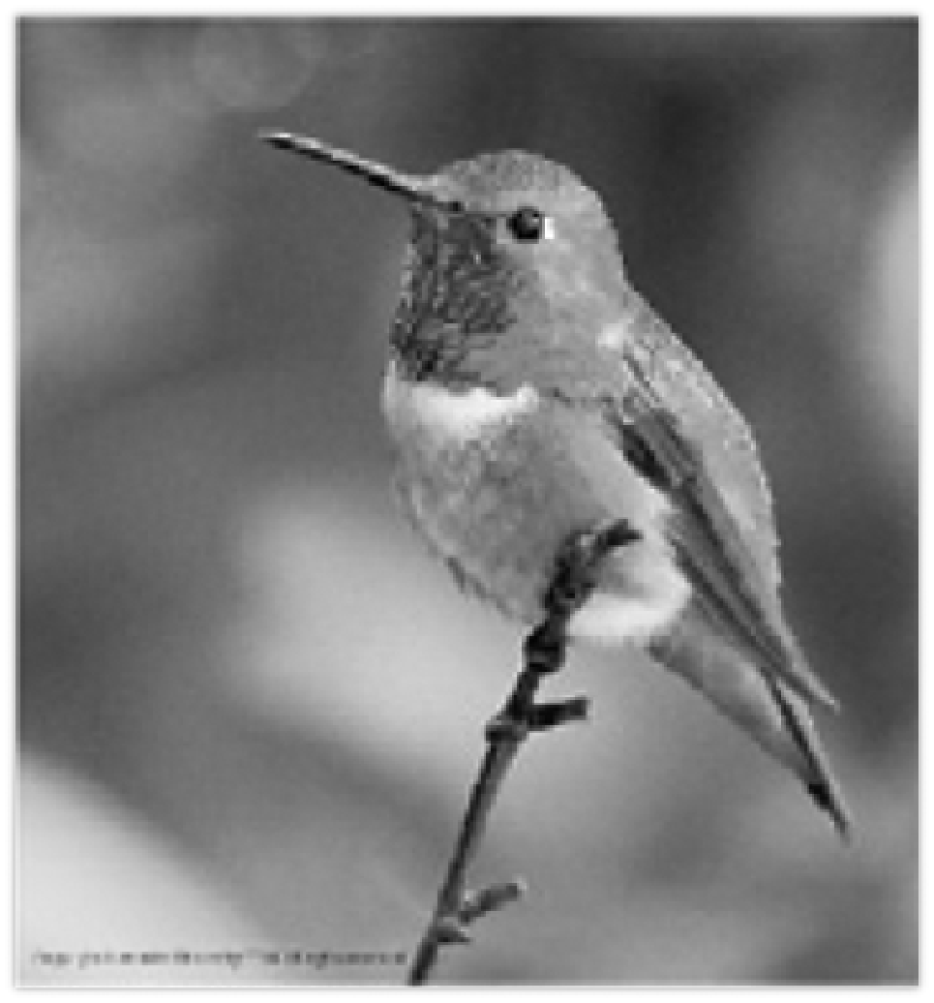
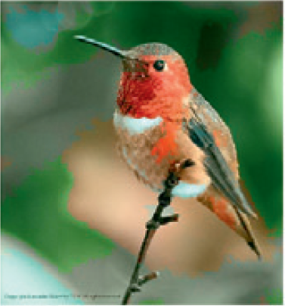
Objective of the colorization
Original
Grayscale image
Recolorized image

Slide 21
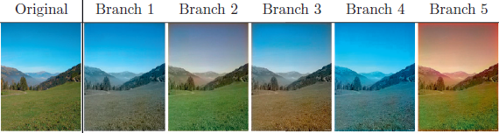
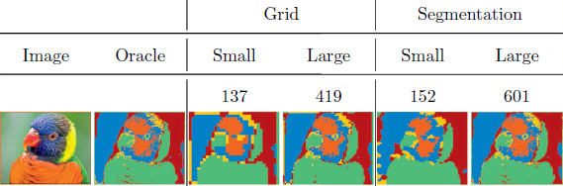
Low-cost colorization
Input: grayscale image + some colors of the image
Colorize hyperpixel created with segmentation using a 5-branch tree

Slide 22
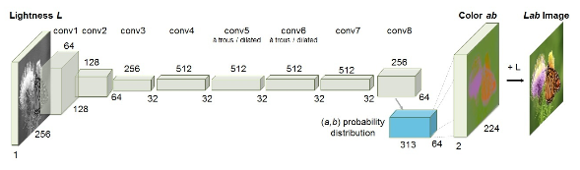
Zero-cost colorization
Goal : Having realistics colors from a grayscale image
Trained on more than 1 million images
Notes:
2-3 repeated conv/ReLU layers in each conv layer
Fool 32% of human participants

Slide 23
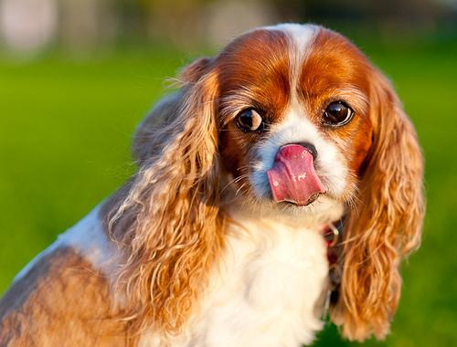
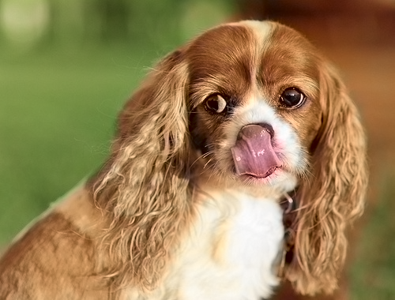
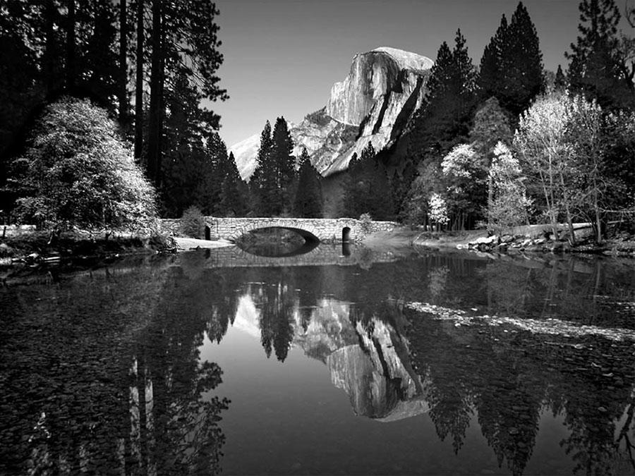
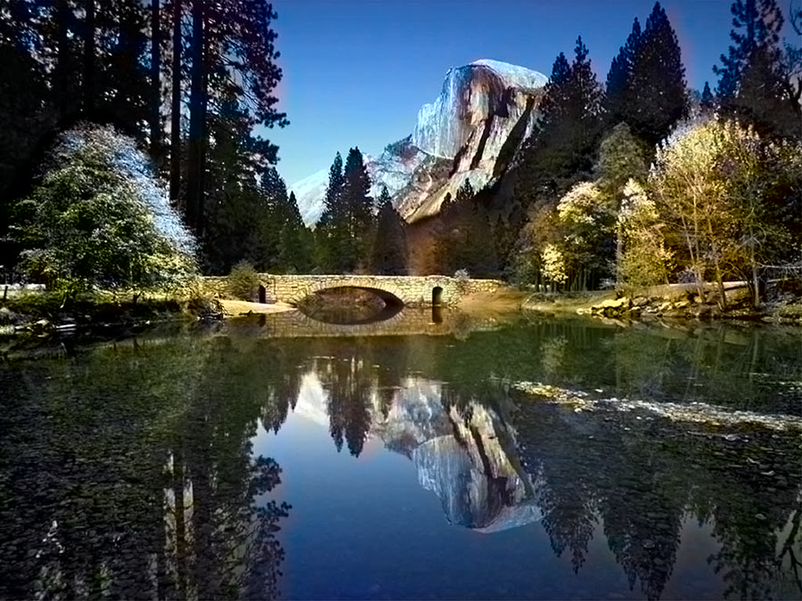
Final result
Original
Recolorized

Slide 24
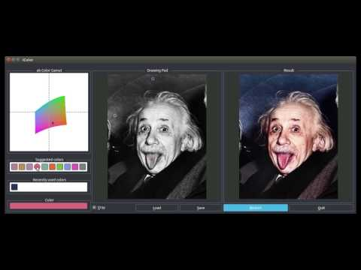

Slide 25
The final pipeline

Slide 26
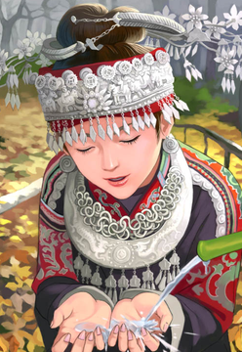
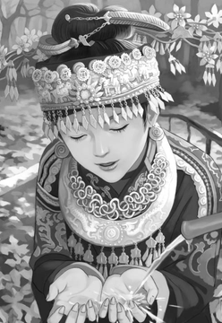
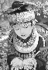
Outline of the pipeline
263kB
88.4kB
6.38kB
2.07kB
Reducing size
Original picture
Black and white
Downsized
.bpg
Getting the image back
Decoded colored picture
Black and white
Black and white downsized
.bpg
Notes:
GSM = 1kB/s => 263 seconds (2 minutes) to 2 seconds.

Slide 27
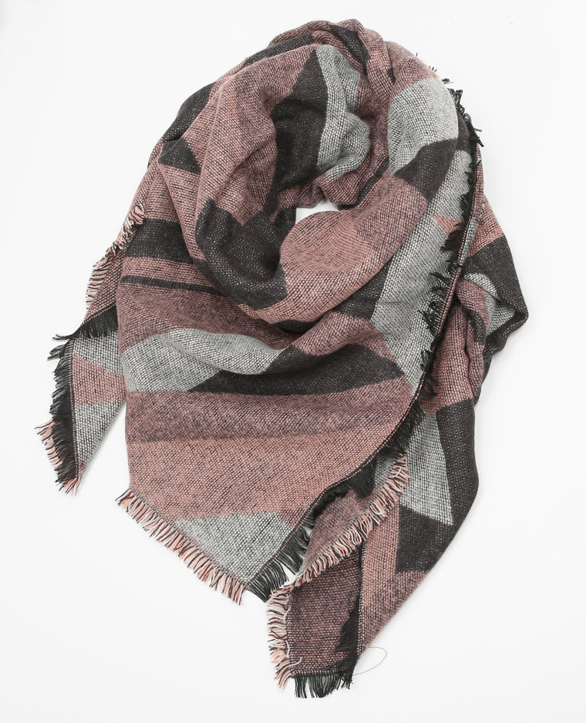
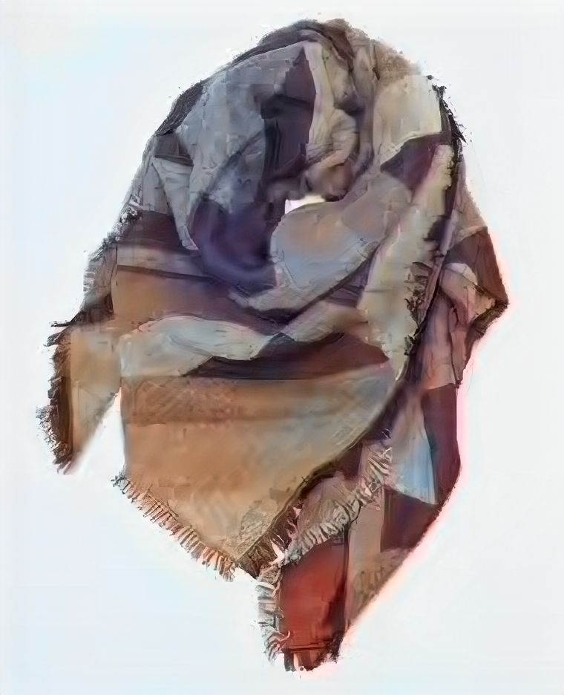

Slide 28
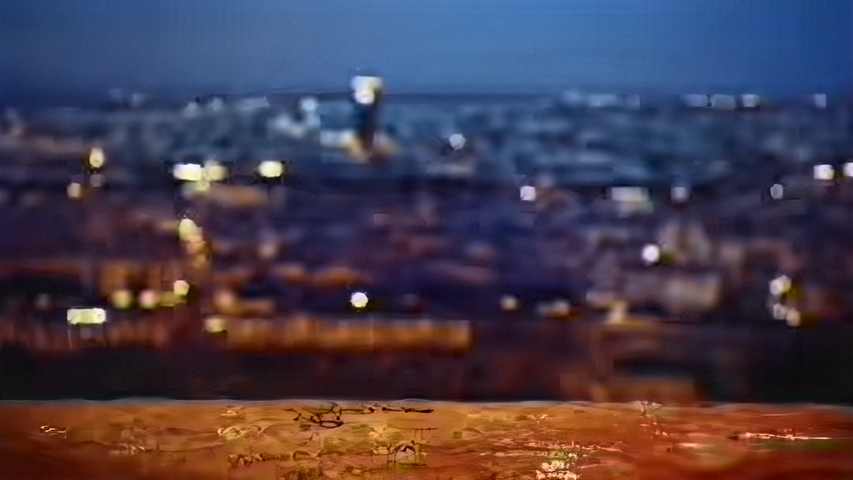
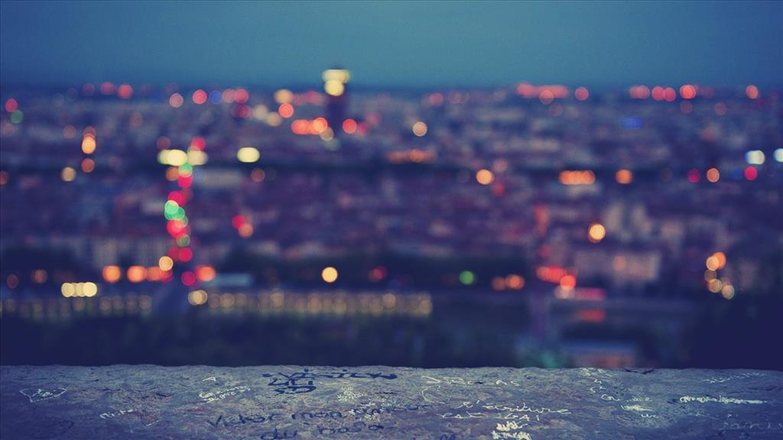

Slide 29
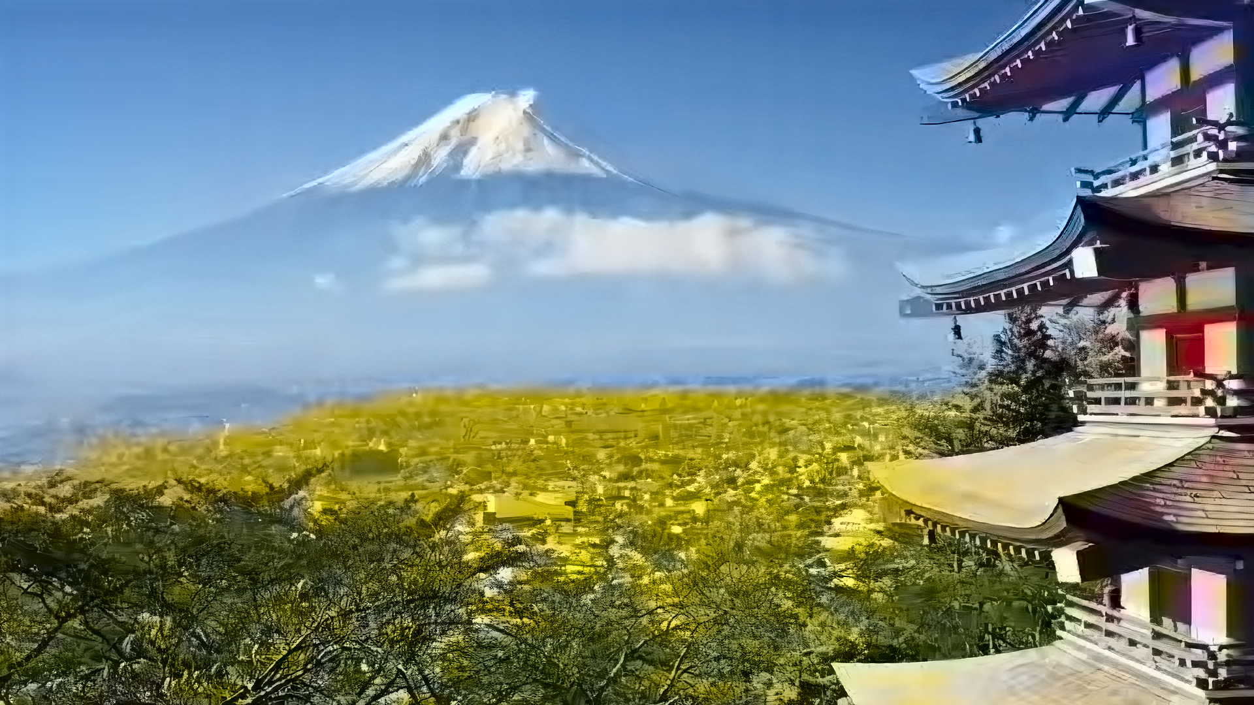
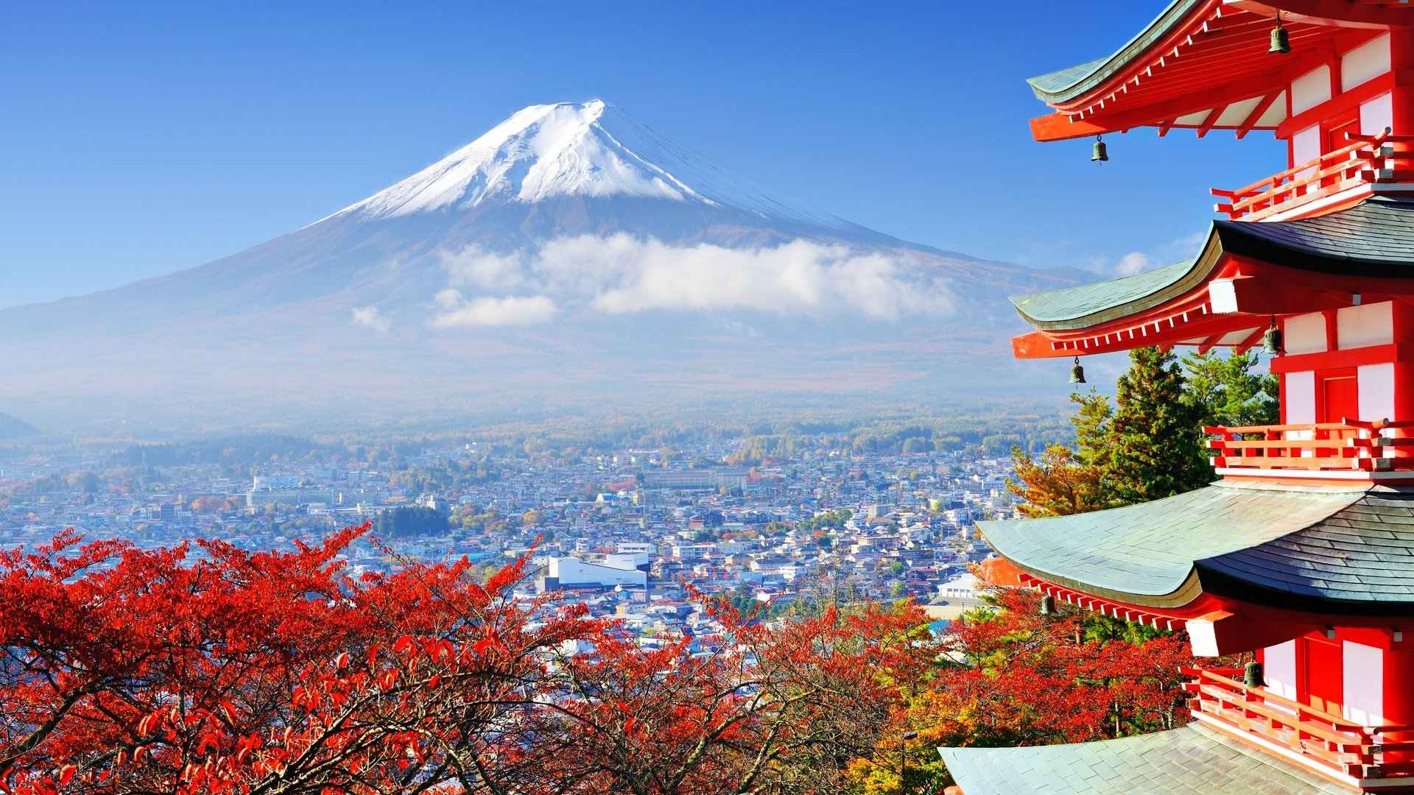

Slide 30
Demonstration

Slide 31
Finally, now what?

Slide 32
Today’s limits
Size of the trained neural networks (~300MB each) for a cell phone usage.
Not applicable to artistics pictures (integrity not respected) for now.

Slide 33
Future possible leads
Dataset more diverse to get better results?
Downsize the height and width 2 times (instead of 4).
Improve downsize (using convolution for example).

